Slide 1
IMAT5121 Mobile Robotics
iRobot Create Simulator
COURSEWORK

Slide 2
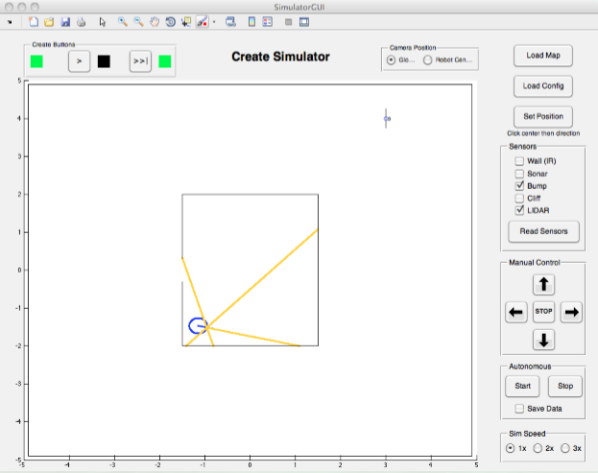
The Environment
For the coursework you should use the map cwMap_MG.txt provided here
The robot’s initial position should be any random place inside the room in the middle of the map

Slide 3
The Environment
The room has a narrow doorway
There is a beacon (which can be positioned anywhere in the map) with a short wall across it, the wall can have any orientation relative to the beacon

Slide 4
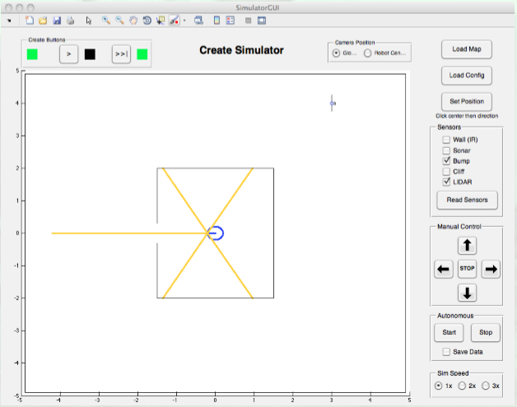
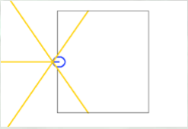
The Task
The iRobot should start anywhere in the room, move around and using the Lidar find the middle of the room
It should then align itself with the exit and come out in a straight line without crashing

Slide 5
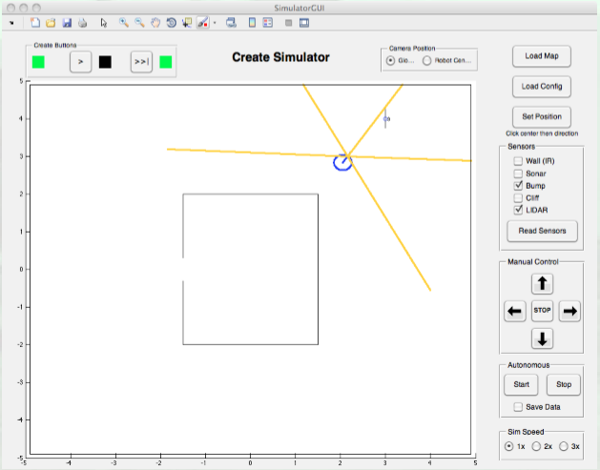
The Task (Cont…)
Once out of the room, the robot should start exploring the environment to find the beacon
Once the beacon is found the iRobot should circle around it “looking” at (and avoiding) the wall

Slide 6
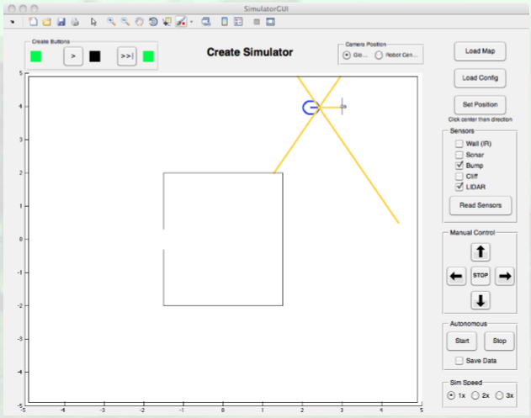
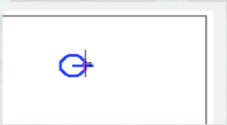
The Task (Cont…)
While circling the beacon, it should be checking its alignment with the wall
The objective is to get perpendicular to it, and when aligned, it should bump it head on

Slide 7
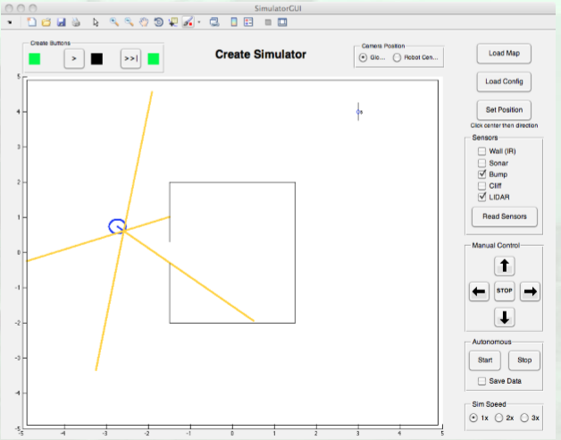
The Task (Cont…)
Once the bump with the wall is detected, the robot will set off to find the room
And of course find the entrance to the room

Slide 8
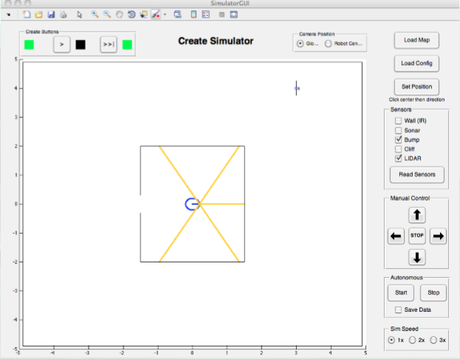
The Task (Cont…)
The final objective is to enter the room without bumping to the sides
And stop exactly in the middle of the room

Slide 9
Some Experimenting
Once your program executes the full task using the map provided, experiment with different setups.
Start the robot in different places
Change the position of the beacon with the short wall across it, and the orientation if the wall… the robot should bump the short wall perpendicular to it

Slide 10
Assessment
You should submit a report explaining how did you tackle the problem and presenting the solution developed by you
Make sure you report the testing and measuring of the performance of the various requirements:
The robot finds the middle of the room
The robot exits/enters the room without bumping
The robot bumps the beacon’s wall perpendicular to it
The robot returns and stops in the middle of the room

Slide 11
Assessment
Make sure you include well documented source code, a good structure with all relevant sections, analysis and conclusions
Submit the work using the turnitin link
This assessment will be 50% of your overall mark

